Slide 1
Basic Electrical and Electronics Engineering
Unit 5 LECTURE 1
Dr. Sonam Shrivastava/ Assistant Professor (Sr.) /SELECT

Slide 2
BEEE102L
Basic Electrical and Electronics Engineering
DC Circuits
AC Circuits
Magnetic Circuits
Electrical Machines
Semiconductor Devices and Applications
Digital Systems

Slide 3
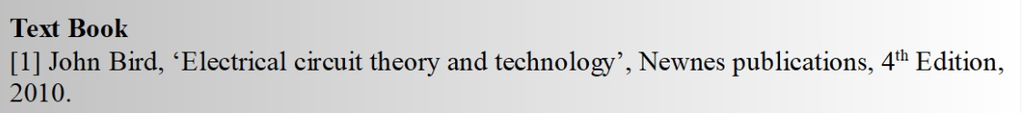
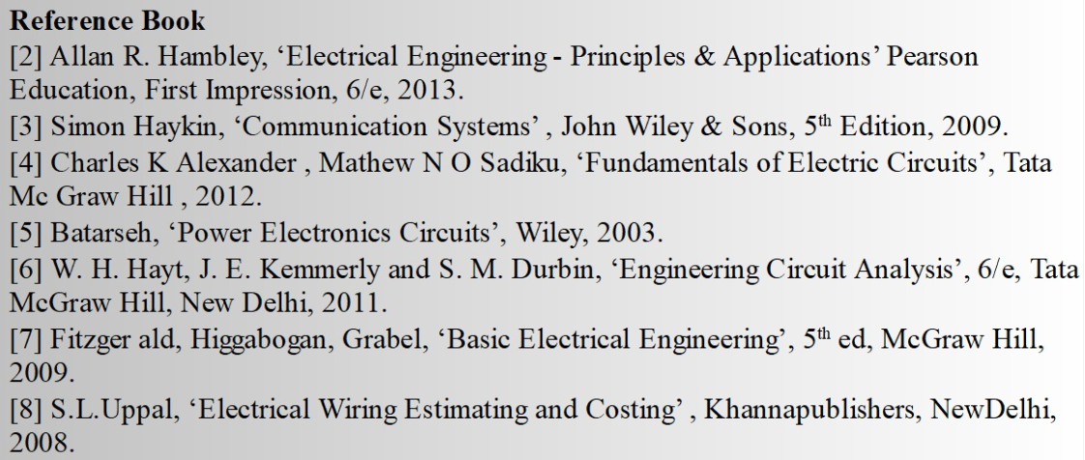
Books

Slide 4
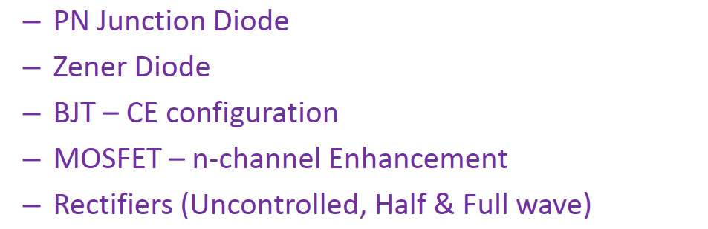
Module V. Semiconductor devices
-- MOFET

Slide 5
Electronic Materials
The goal of electronic materials is to generate and control the flow of an electrical current.
Electronic materials include:
Conductors: have low resistance which allows electrical current flow
Insulators: have high resistance which suppresses electrical current flow
Semiconductors: can allow or suppress electrical current flow

Slide 6
Conductors
Good conductors have low resistance so electrons flow through them with ease.
Best element conductors include:
Copper, silver, gold, aluminum, & nickel
Alloys are also good conductors:
Brass & steel
Good conductors can also be liquid:
Salt water

Slide 7
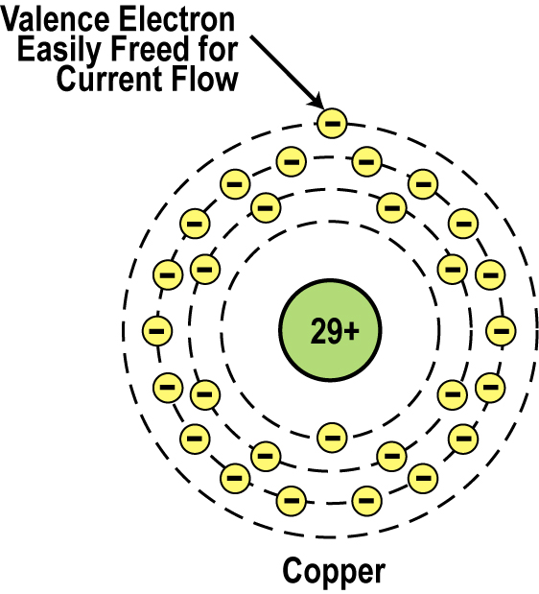
Conductor Atomic Structure
The atomic structure of good conductors usually includes only one electron in their outer shell.
It is called a valence electron.
It is easily striped from the atom, producing current flow.
2, 8,18, 1
Copper Atom

Slide 8
Insulators
Insulators have a high resistance so current does not flow in them.
Good insulators include:
Glass, ceramic, plastics, & wood
Most insulators are compounds of several elements.
The atoms are tightly bound to one another so electrons are difficult to strip away for current flow.

Slide 9
Semiconductors
Semiconductors are materials that essentially can be conditioned to act as good conductors, or good insulators, or any thing in between.
Common elements such as carbon, silicon, and germanium are semiconductors.
Silicon is the best and most widely used semiconductor.

Slide 10
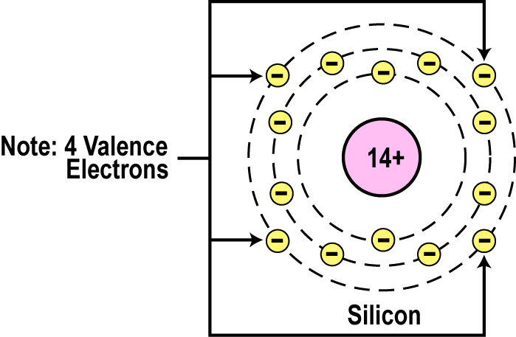
Semiconductor Valence Orbit
The main characteristic of a semiconductor element is that it has four electrons in its outer or valence orbit.
2, 8, 4

Slide 11
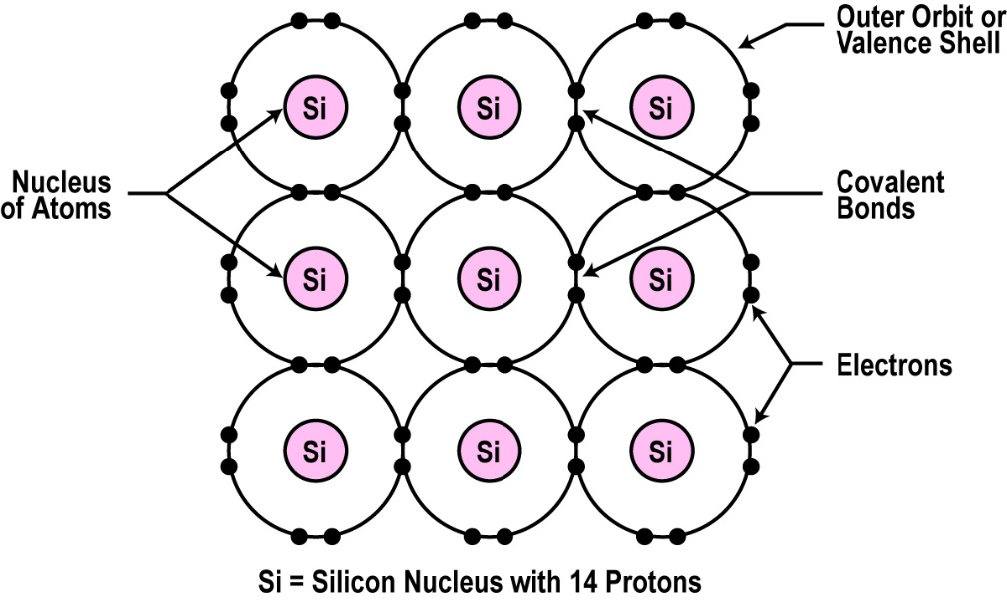
Crystal Lattice Structure
The unique capability of semiconductor atoms is their ability to link together to form a physical structure called a crystal lattice.
The atoms link together with one another sharing their outer electrons.
These links are called covalent bonds.
2D Crystal Lattice Structure

Slide 12
Semiconductors can be Insulators
If the material is pure semiconductor material like silicon, the crystal lattice structure forms an excellent insulator since all the atoms are bound to one another and are not free for current flow.
Good insulating semiconductor material is referred to as intrinsic.
Since the outer valence electrons of each atom are tightly bound together with one another, the electrons are difficult to dislodge for current flow.
Silicon in this form is a great insulator.
Semiconductor material is often used as an insulator.

Slide 13
Doping
To make the semiconductor conduct electricity, other atoms called impurities must be added.
“Impurities” are different elements.
This process is called doping.
The doped semiconductor material is called as extrinsic semiconductor.
The conductivity of extrinsic semiconductor is good.

Slide 14
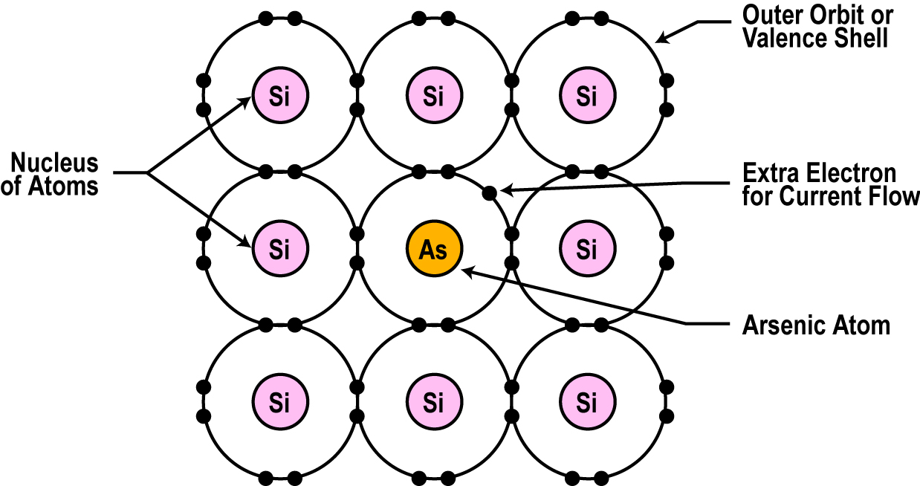
Semiconductors can be Conductors
An impurity, or element like arsenic, has 5 valence electrons.
Adding arsenic (doping) will allow four of the arsenic valence electrons to bond with the neighboring silicon atoms.
The one electron left over for each arsenic atom becomes available to conduct current flow.

Slide 15
Resistance Effects of Doping
If you use lots of arsenic atoms for doping, there will be lots of extra electrons so the resistance of the material will be low and current will flow freely.
If you use only a few boron atoms, there will be fewer free electrons so the resistance will be high and less current will flow.
By controlling the doping amount, virtually any resistance can be achieved.

Slide 16
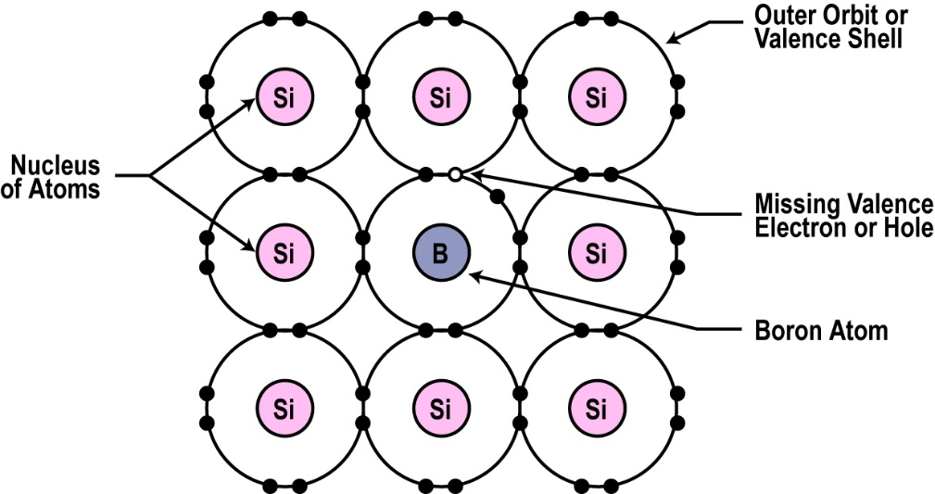
Another Way to Dope
You can also dope a semiconductor material with an atom such as boron that has only 3 valence electrons.
The 3 electrons in the outer orbit do form covalent bonds with its neighboring semiconductor atoms as before. But one electron is missing from the bond.
This place where a fourth electron should be is referred to as a hole.
The hole assumes a positive charge so it can attract electrons from some other source.
Holes become a type of current carrier like the electron to support current flow.

Slide 17
Types of Semiconductor Materials
The silicon doped with extra electrons is called an “N type” semiconductor.
“N” is for negative, which is the charge of an electron.
Silicon doped with material missing electrons that produce locations called holes is called “P type” semiconductor.
“P” is for positive, which is the charge of a hole.

Slide 18
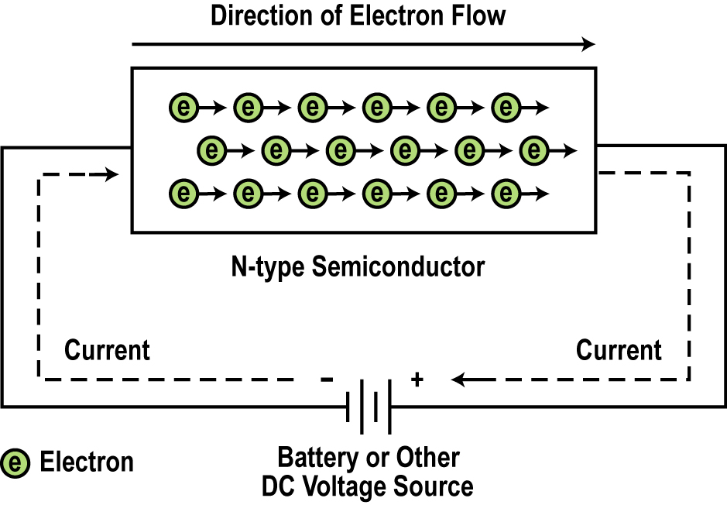
Current Flow in N-type Semiconductors
The DC voltage source has a positive terminal that attracts the free electrons in the semiconductor and pulls them away from their atoms leaving the atoms charged positively.
Electrons from the negative terminal of the supply enter the semiconductor material and are attracted by the positive charge of the atoms missing one of their electrons.
Current flows from the negative terminal to the positive terminal.

Slide 19
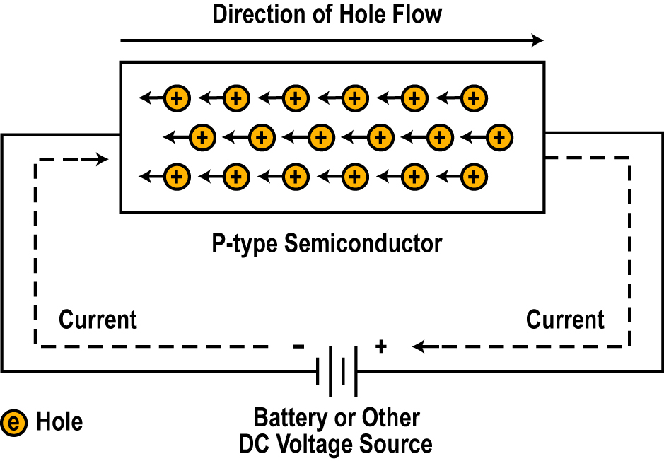
Current Flow in P-type Semiconductors
Electrons from the negative supply terminal are attracted to the positive holes and fill them.
The positive terminal of the supply pulls the electrons from the holes leaving the holes to attract more electrons.
Current flows from the negative terminal to the positive terminal.
Inside the semiconductor current flow is actually by the movement of the holes from positive to negative.

Slide 20
Majority and Minority Carriers
Two currents through a diode:
Majority Carriers
The majority carriers in n-type materials are electrons.
The majority carriers in p-type materials are holes.
Minority Carriers
The minority carriers in n-type materials are holes.
The minority carriers in p-type materials are electrons.

Slide 21
In Summary
In its pure state, semiconductor material is an excellent insulator.
The commonly used semiconductor material is silicon.
Semiconductor materials can be doped with other atoms to add or subtract electrons.
An N-type semiconductor material has extra electrons.
A P-type semiconductor material has a shortage of electrons with vacancies called holes.
The heavier the doping, the greater the conductivity or the lower the resistance.
By controlling the doping of silicon the semiconductor material can be made as conductive as desired.

Slide 22
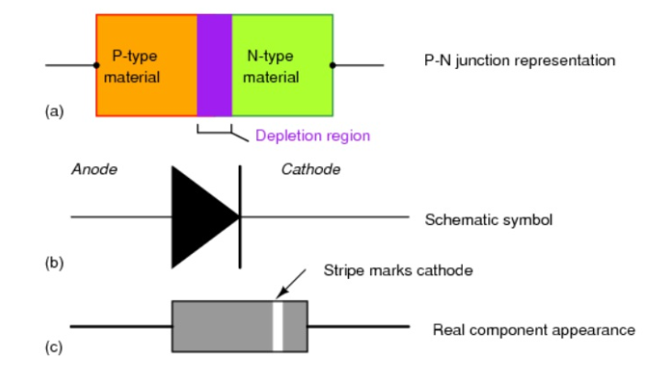
PN junction diode

Slide 23
PN junction diode
In a piece of semiconductor material, if one half is doped by P-type and the other half is doped by N-type impurity, a PN junction is formed.
The plane dividing the two halves or zones is called PN junction.
The N-type has high concentration of free electrons while P-type has high concentration of holes. Therefore at the junction there is a tendency for the free electrons to diffuse over to the P-side and holes to the N-side (process called diffusion).
The net opposite charge in each layer prevents further diffusion into that layer.
Thus a barrier is set up near the junction which prevents further movement of charge carriers. This is called as potential barrier (0.3V for germanium and 0.7 for silicon).

Slide 24
Diode Operating Conditions
A diode has three operating conditions:
No bias
Forward bias
Reverse bias

Slide 25
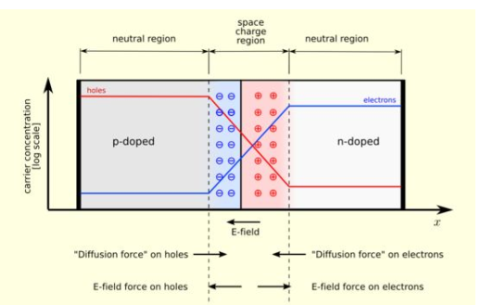
PN junction unbiased diode

Slide 26
Forward bias
When positive terminal of battery is connected to the P-type and negative terminal to the N-type of the PN junction diode, the bias applied is known as forward bias.
The applied positive potential repels the holes in the P-type region so that the holes move towards the junction and the applied negative potential repels the electrons in the N-type region and the electrons move towards the junction(When applied voltage VF is less than V0) and hence the forward current IF is almost zero.
Eventually when the applied potential is more than the internal barrier potential the barrier will disappear
Hence the holes cross the junction from P-type to N-type and the electrons cross the junction in the opposite direction resulting in relatively large current flow in the external circuit.

Slide 27
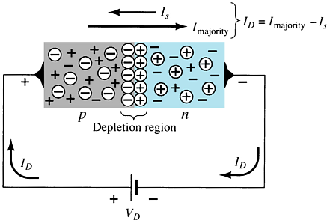
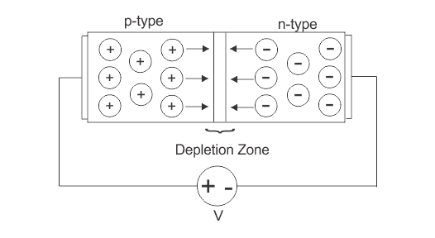
Forward Bias
Anode is given positive potential
Cathode is given negative potential

Slide 28
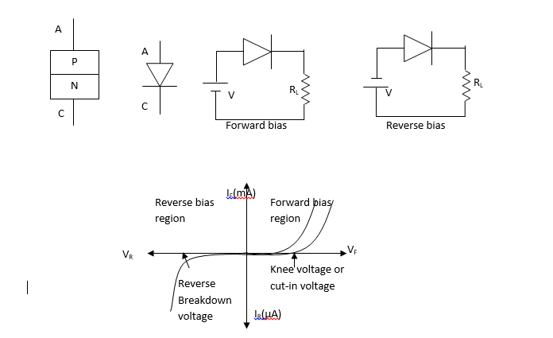

Slide 29
Under reverse bias condition:
When the negative terminal of the battery is connected to the P-type and positive terminal is connected to N-type of the PN junction, the bias applied is known as reverse bias.
Under this condition, holes form the majority carriers of P-side move towards the negative terminal of the battery and electrons which form the majority carriers of the N-side are attracted towards the positive terminal of the battery.
Hence the width of the depletion region which is depleted of mobile carriers increases.
Thus the electric filed produced by applied reverse bias is in the same direction of electric field and hence the barrier is increased.
Therefore, theoretically no current should flow in the external circuit.
But in practice very small reverse current in the order of microamperes flows under bias. This current is called as reverse saturation current.

Slide 30
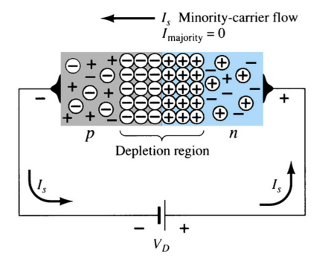
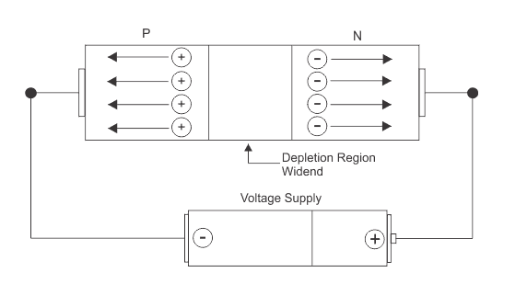
Reverse Bias
Anode is given negative potential
Cathode is given positive potential

Slide 31
The magnitude of reverse saturation current mainly depends upon junction temperature because the major source of minority carriers is thermally broken covalent bonds.
For large reverse bias is applied,
The free electrons from the N-type moving towards the positive terminal of the battery acquire sufficient energy to move with high velocity to dislodge valence electrons from semiconductor atom in the crystal.
Thus large number of free electrons are formed which is commonly called as avalanche of free electrons. This leads to the breakdown of junction leading to very large reverse current. The reverse voltage at which the junction breakdown is known as breakdown voltage.

Slide 32
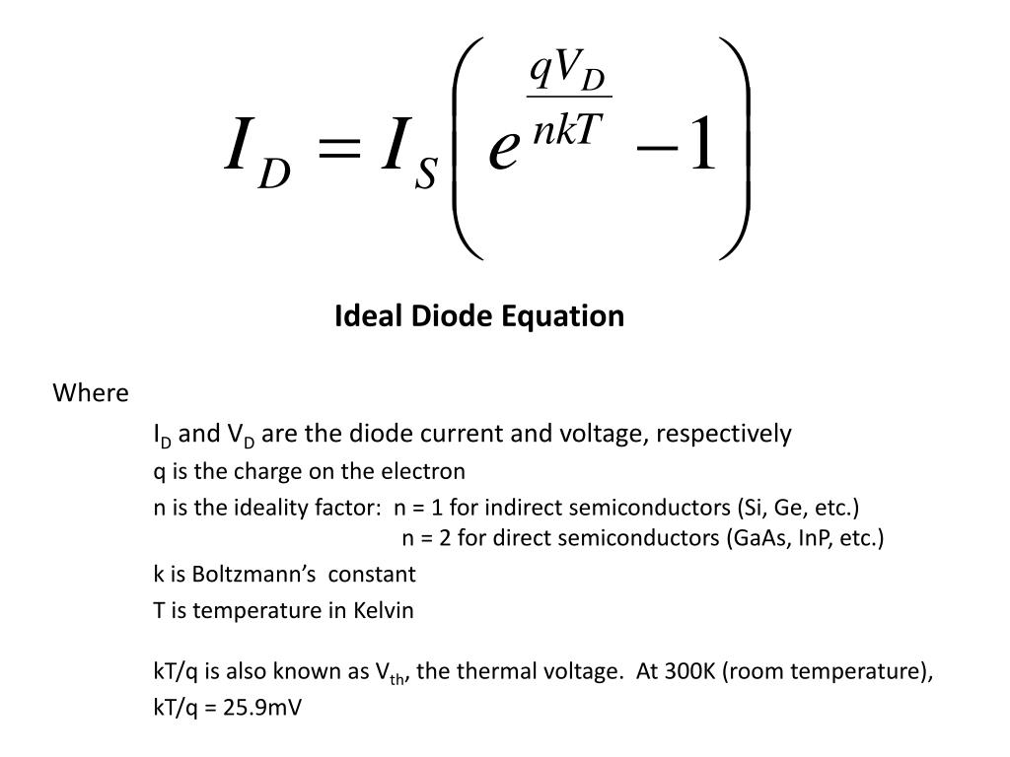
Diode Operating Conditions

Slide 33
S. No. | Topic | Link
1 | PN Junction diode | https://www.youtube.com/watch?v=btOIDQeMrMg&t=199s
2 | Zener Diode | https://www.youtube.com/watch?v=V5nWu8EbMhI&t=33s
3 | BJT | https://www.youtube.com/watch?v=fIvZen2tq_w
4 | Rectifier | https://www.youtube.com/watch?v=quyqtaKIr78
5 | MOSFET | https://www.youtube.com/watch?v=Bfvyj88Hs_o

Slide 34
Thank you

